Slide 1

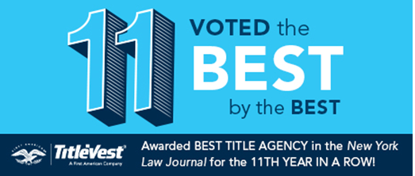

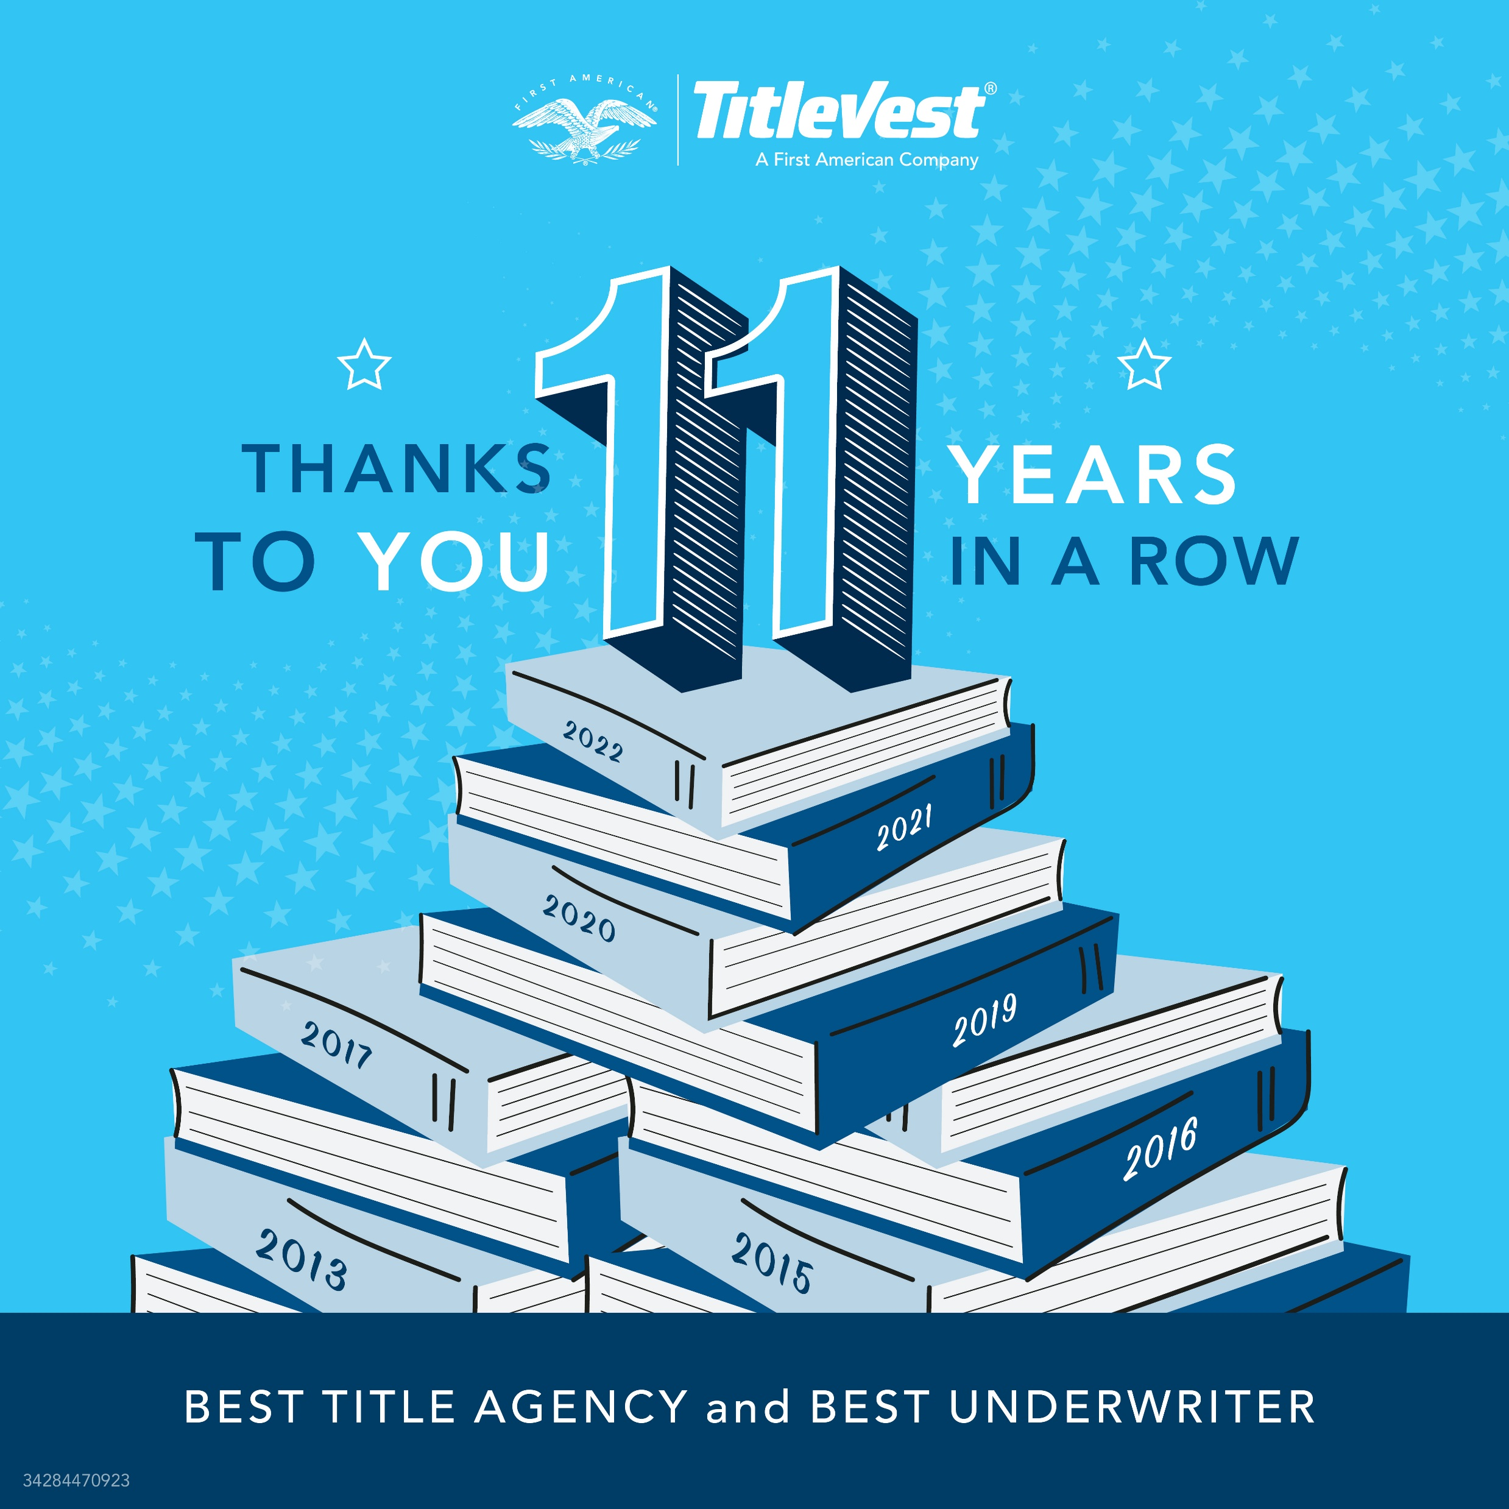
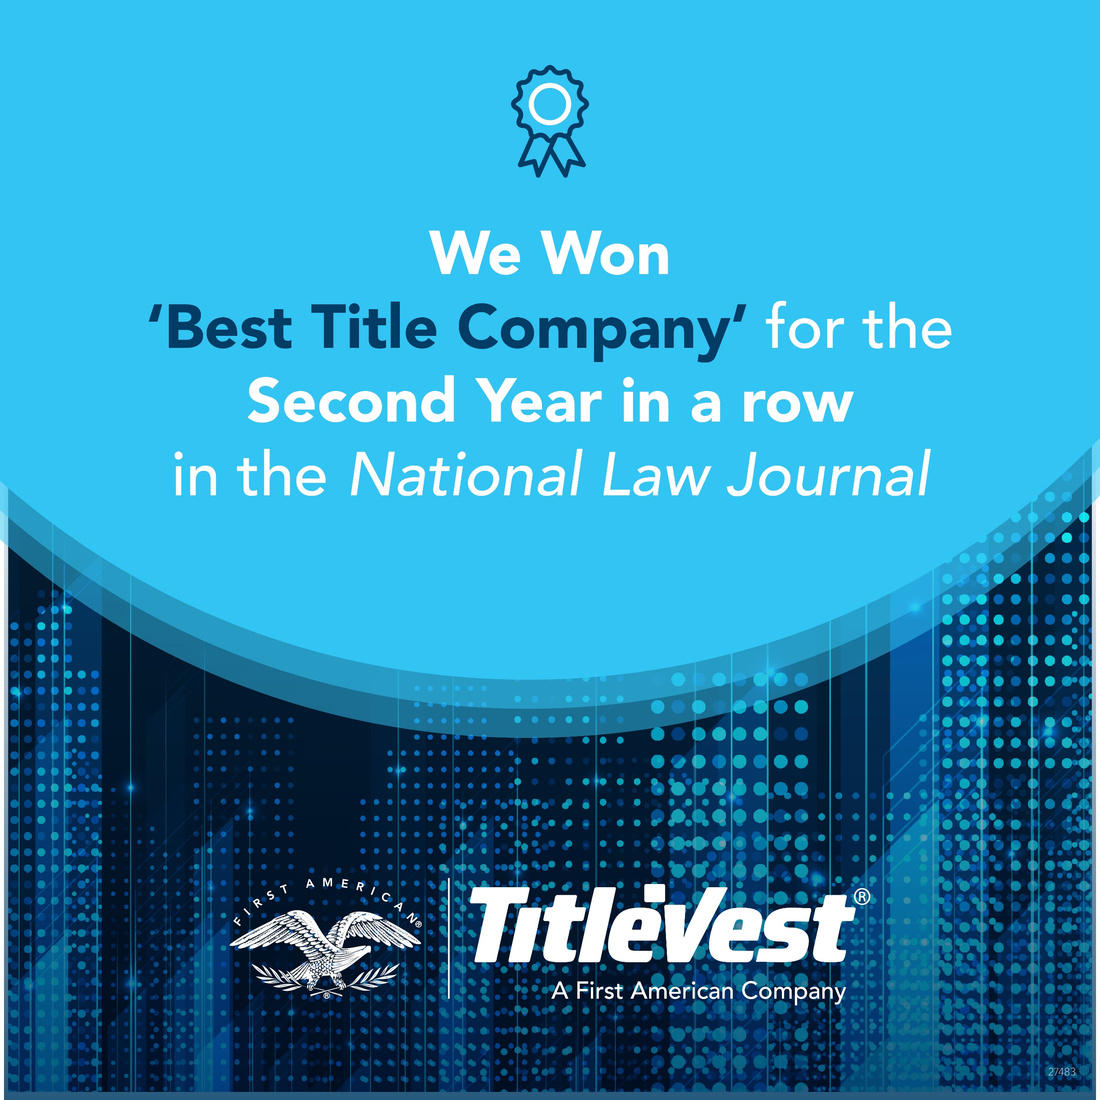
Consistently awarded best title company locally and nationally
Why TitleVest
The crowds have spoken and TitleVest has been awarded Best Title Company for eleven years running… for a few good reasons from our unique multi-underwriter status to our unique asset/team structuring to our national footprint and our cutting-edge technologies.

Slide 2

Consistently awarded best title company locally and nationally
Case Study 1
Hamptons Residential Purchase
Delivered Title in <96 Hours
Creative Structuring Guidance
Minimize Transactional Taxes
Saving Client $70k+ at Closing

Slide 3
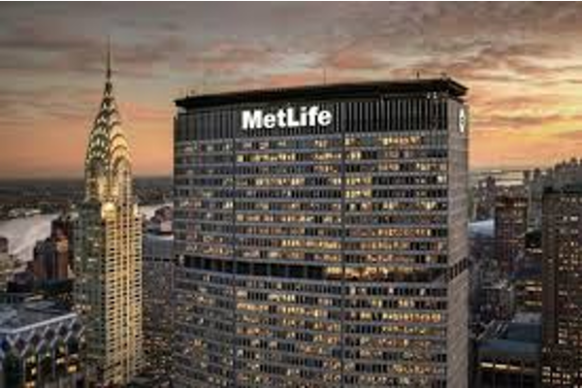
Consistently awarded best title company locally and nationally
Case Study 2
NYC Commercial Refinance
Syndicating $1.55B in Risk
Consolidating Paperwork Saved $20k+ in Legal Costs
Debt Structuring Advice Saved Client $1M+ in Title Costs
Saved their lawyers a lot of face

Slide 4

Consistently awarded best title company locally and nationally
National Coverage
Each team at TitleVest is directly licensed and trained to handle their type of transaction (e.g. residential purchase, digital infrastructure, solar, cannabis, etc.) across all 44 direct coverage states (plus DC).
The client gets the benefit of working with the same intimate team of 3-5 people to handle every one of their transactions no matter the geographic location.
The same team plays quarterback in only six typically low-volume states.

Slide 5

Consistently awarded best title company locally and nationally
Case Study 3
NY Firm – National Real Estate
NYC Based (57th St.) with $34B in Assets Under Management
Serviced 400+ Residential Home Portfolio Purchase
Delivered Fast & Under Budget
Corp Structure Advice Saved $400k+

Slide 6
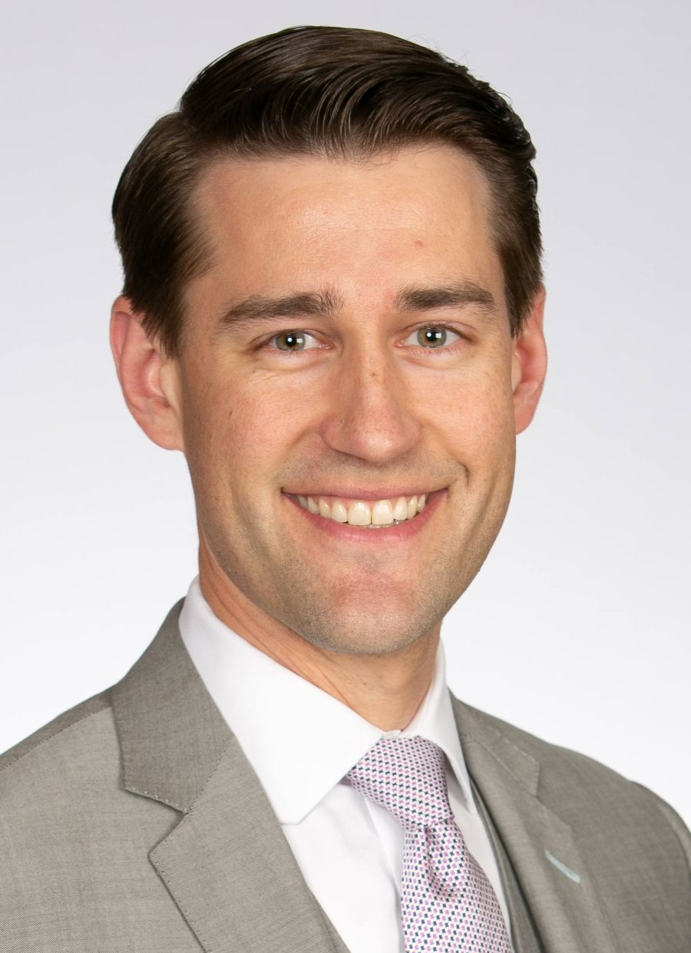
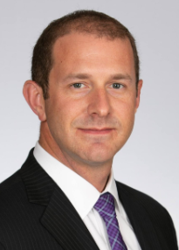
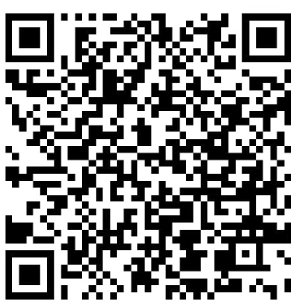
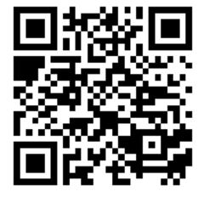



Consistently awarded best title company locally and nationally
About
Clients
Why TitleVest
Connections
Purchasers of Real Estate
Real Estate Attorneys
Coop & Condo Apartments
Single Family & Townhouses
Multi-Family & Mixed Use
Commercial & Industrial
Innovative Tools & Tech
Envelope
Simplex
IgniteRE
6,000 Coop and Condo Offering Plans Sightline
Acris ASAP
Residential & Commercial RE Attorneys
Bank / Lender Attorneys
Buyers and Investors
Brian Tormey
President, TitleVest
James Melnichok
Sales Representative
Attorneys
Commercial and Residential Developers
Buyer’s Attorneys with 3 to 300 deals annually
Transfer Agents
Bank Attorneys
White Glove Service
Lenders
Responsive, Breadth of Knowledge
Residential and Commercial
Financial Services
Real Estate Brokerages
Mortgage Loan Officers
SBA Lenders
Private Equity
Underwriting Capacity
Commercial and Residential
National Title Insurance
Owned by most respected underwriter
Flexibility to underwrite with other top seven underwriters
Coop and Managing Agents
Direct coverage in 44 States + DC
Geographically
Best RE Tech
Direct in 44 States, Indirect in 6 States
Continuing Education
National Network of
Real Estate Professionals
Delivering top tech for RE pros
Regularly Hosts CLE and CE Classes for Attorneys and Real Estate Agents
Specialized Comm. Services
Coop Services
Single Family Residential (SFR)
Renewables (Solar, Wind, Battery)
Digital Infrastructure (Cell, Fiber, Data Center)
Franchises
Clients, offices and referral partners throughout the United States
Top Industry Awards
Only Resource for Eagle 9 Coverage
National Law Journal Two Years
New York Law Journal 11 Years
1031 Exchange
Qualified Intermediary

Slide 7
Consistently awarded best title company locally and nationally
Clients
Connections
Purchasers of Real Estate
Financial Services
Real Estate Attorneys
Lenders
Coop & Condo Apartments
Single Family & Townhouses
Multi-Family & Mixed Use
Commercial & Industrial
Mortgage Loan Officers
SBA Lenders
Private Equity
Residential & Commercial RE Attorneys
Bank / Lender Attorneys
Residential and Commercial
Real Estate Brokerages
Geographically
Commercial and Residential Agents in NY & Elsewhere
Buyers and Investors
Attorneys
Direct in 44 States, Indirect in 6 States
Commercial Building Owners/Operators
Residential Developers
Buyer’s Attorneys with 3 to 300 deals annually
Transfer Agents
Bank Attorneys
Coop and Condo Managing Agents
Specialized Comm. Services
Single Family Residential (SFR)
Renewables (Solar, Wind, Battery)
Digital Infrastructure (Cell, Fiber, Data Center)
Franchises
National Real Estate Professionals
Clients, offices and referral partners throughout the United States

Slide 8
Consistently awarded best title company locally and nationally
Contact Us:
James Melnichok
Managing Director, Client Services
James.Melnichok@TitleVest.com
917.371.0046
Brian D. Tormey, NTP
President, TitleVest
Northeast Regional Manager, First Am
Brian@TitleVest.com
917.696.8039

Slide 9
Impressing Clients
Consistently awarded best title company locally and nationally – give us a try to learn why!

